Slide 1
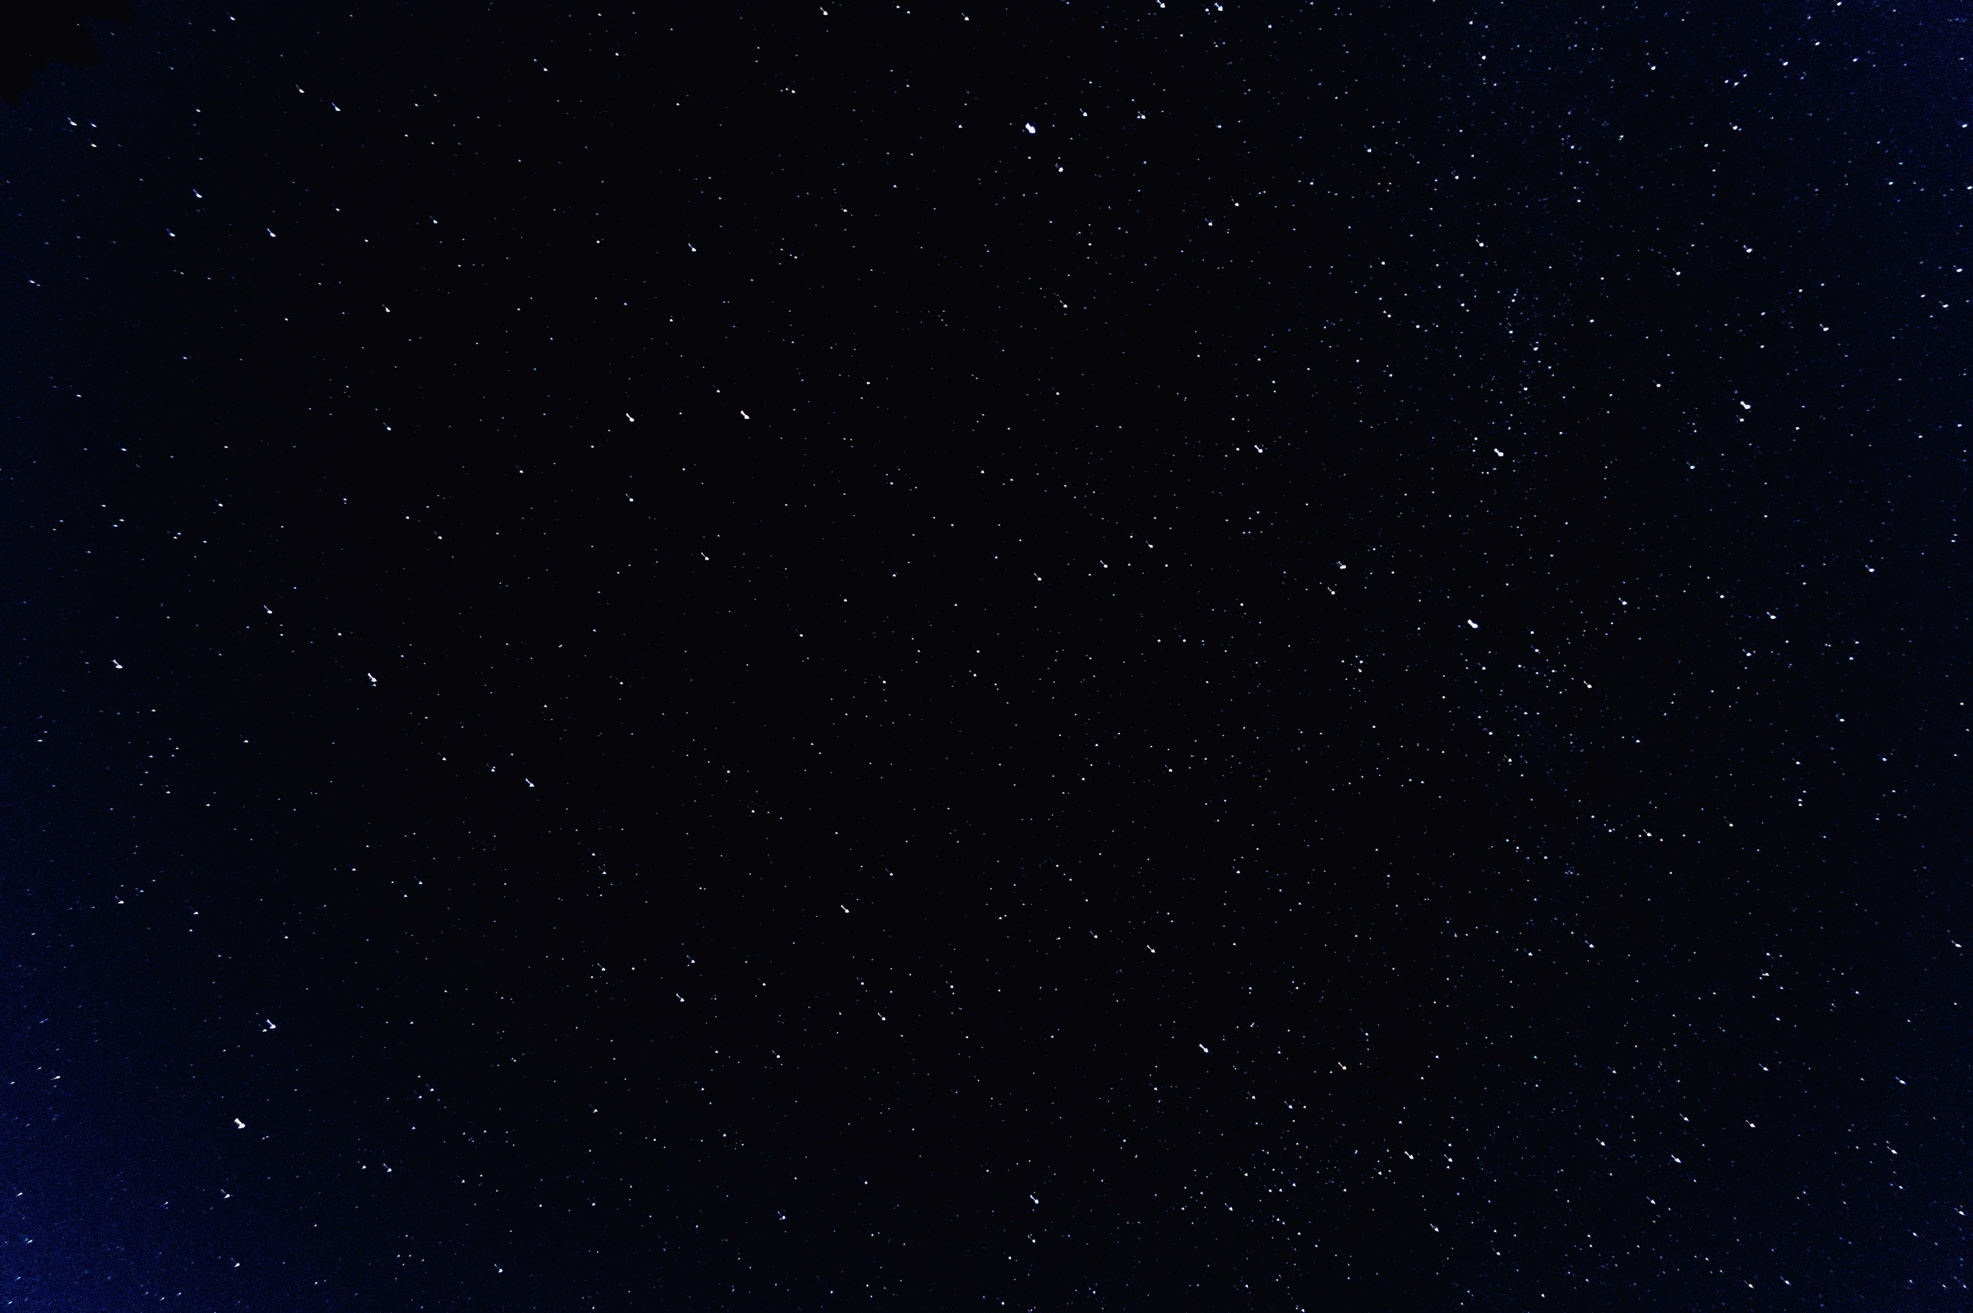

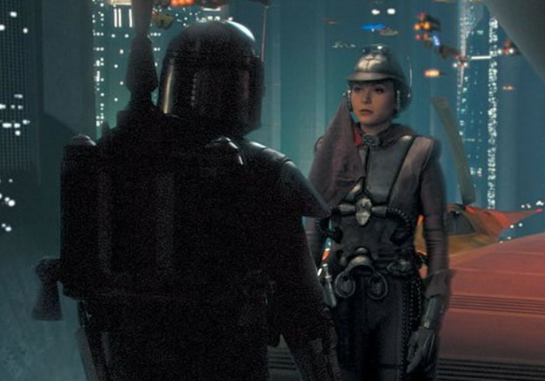
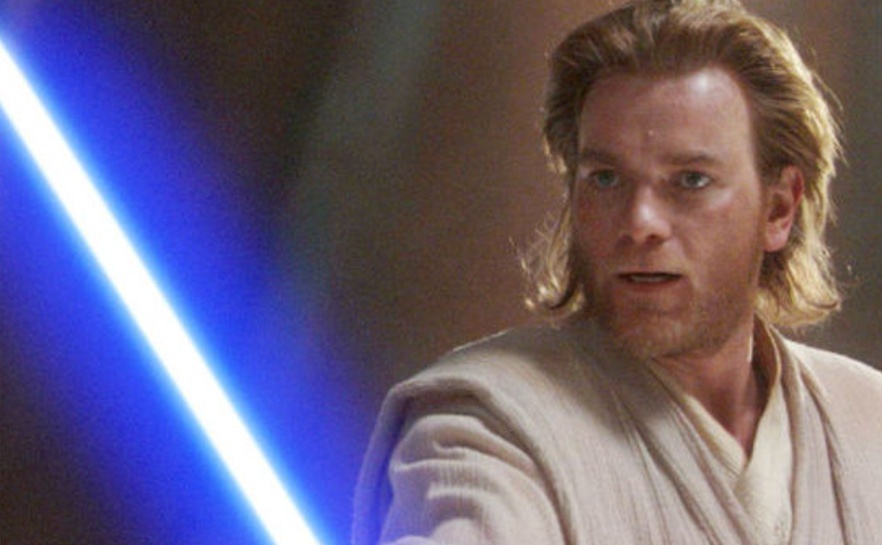
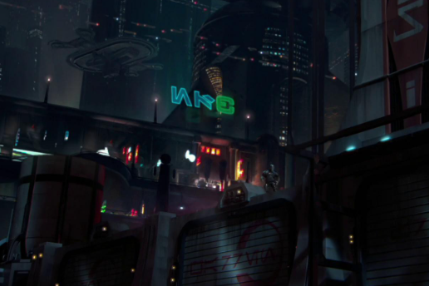
Trouble on Coruscant! Jedi Master Obi-Wan-Kenobi and his padawan Anakin Skywalker are tasked with protecting Senator Padme Amidala after she has been targeted by multiple attacks from an unknow bounty hunter. Kenobi and Skywalker have chased a bounty hunter through the depths of Coruscant to uncover the identity of the unknown attacker, they track down non other than Zam Wessel who reveals that she is working for someone far more mysterious, before she reveals more she is killed by a poisoned dart! Kenobi is tasked with tracking down this mysterious character and discovering their true motives…

Slide 2
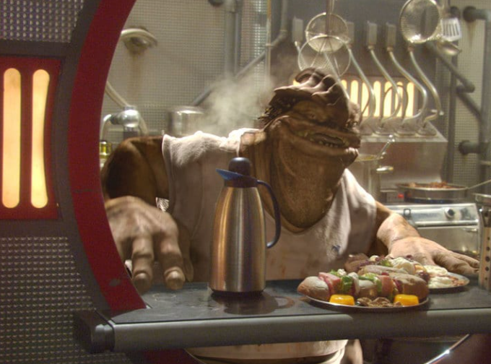
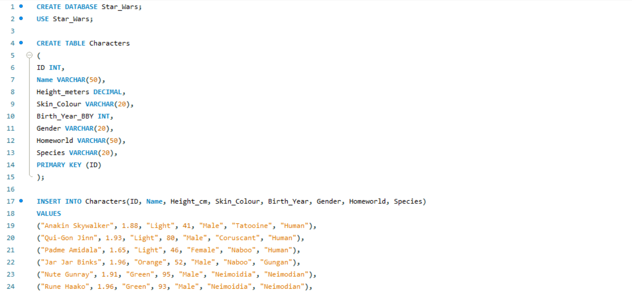
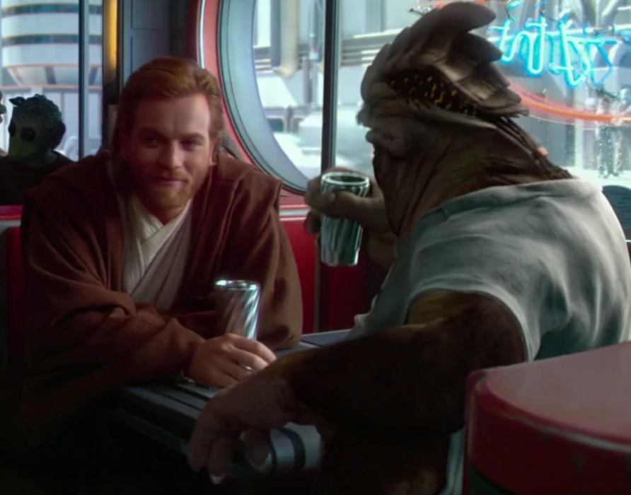
Kenobi gathers what evidence he has already, the brief encounter allowed the Jedi to grab some details on this mysterious character below is what he has so far…
The first place Kenobi visits is Dexter Jettster Diner, Dex has seen and heard it all in his time living on the busy planet of Coruscant, many different characters come to his diner and word gets around pretty fast. Dex has created a database on significant characters he has encountered in the past and is willing to work with Kenobi to filter down potential characters who may be behind these troubling attacks
Dex’s Data
Height – Average (Male)
Gender – Presumably Male
Weapon - Blaster
Clothing - Armour

Slide 3
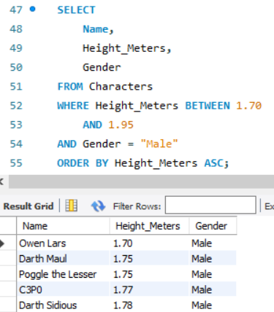
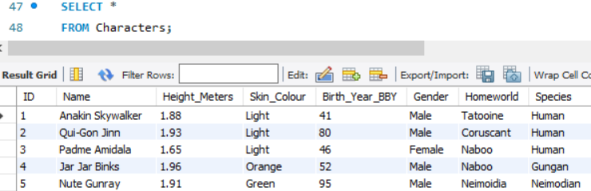
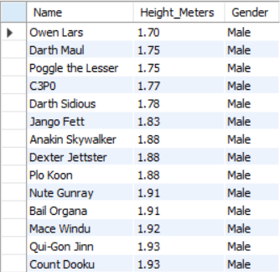
Dex takes the information Kenobi has given him and queries his data based upon the rough outline Kenobi has provided…
Now Dex runs a script selecting the names, heights and genders in the Characters table. Dex uses a WHERE clause to return around the average height of males according to Kenobi’s notes, this value is BETWEEN 1.70 AND 1.95 meters. Dex further queries the data to return only males and orders the data in ascending height order. The data returns a list of fourteen potential culprits, including Dexter himself! Yikes!!
The first thing Dex does is looks at his database, he has a table called characters in that database which contains the information he has gathered. Dex uses a SELECT * to see all the columns he has in his database and checks to see if any of Kenobi’s notes are represented in the data. Dex finds that he has information on the heights and genders of the characters as well as additional information which can help filter out potential criminals

Slide 4
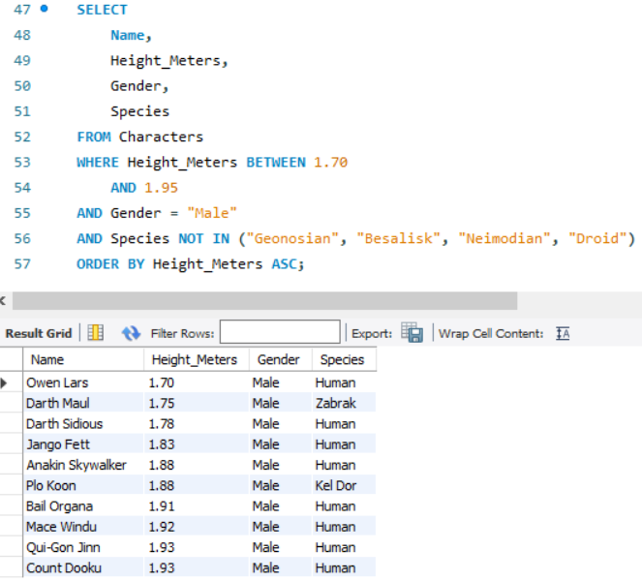
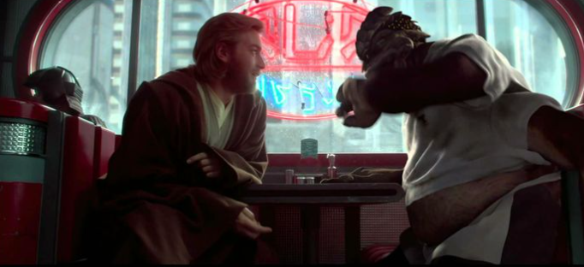
Dex talks to Kenobi and they both clearly acknowledge it couldn’t be Dex since, well, he is a little large to fit in the armour Kenobi witnessed! Dex decides to go back to the data and exclude values which are clearly not going to be the culprit due to their alien like body frame not fitting Kenobi's visual description, Dex achieves this by using a NOT IN statement to filter out species that the culprit will certainly not be
Dex returns the information he has collected, however we now have a list of ten potential culprits, this is way too many for Kenobi to investigate, the data returned also doesn’t provide a lot of insight into where to find these people, Kenobi realises this data isn’t enough to make a final decision on the case and decides to search for additional data to finish his investigation, Kenobi saves this data and leaves Dexters Diner…

Slide 5
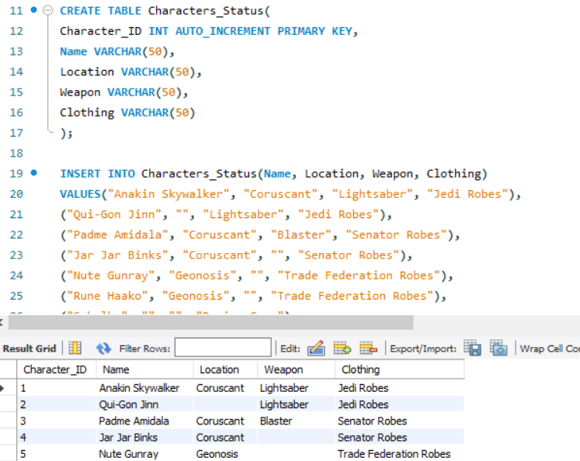
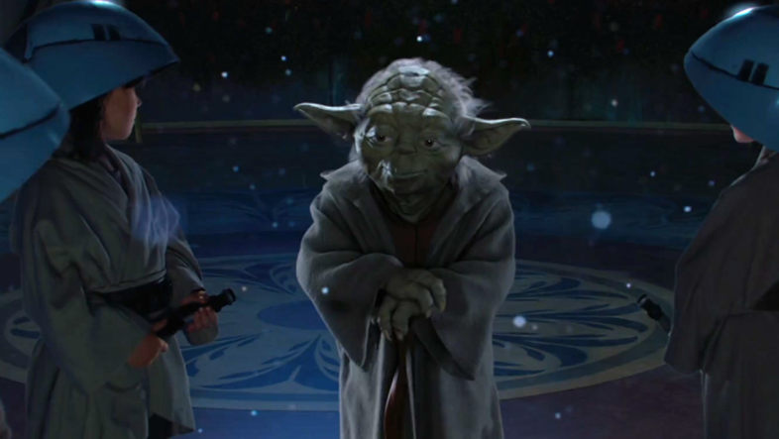
Obi-Wan-Kenobi heads to the Jedi temple and checks the archives of the Jedi data collected over thousands of years, however when looking for the data he finds that there are many NULL values, the data has been deleted! Kenobi goes to consult Yoda on the matter
This news is concerning to the Jedi, why would somebody remove such important data? Yoda however has a database of his own, this database uses his force powers to highlight specific details of many different characters, this additional information is extremely useful to Kenobi as it adds an extra layer of information for him to draw insight on who the perpetrator may be
“The data must have been erased” – Yoda Film Quote Attack of the Clones 2002

Slide 6
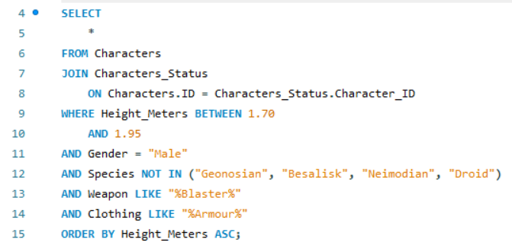
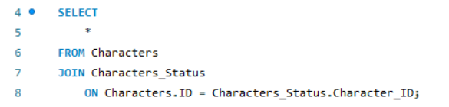
Wow the data collected from Yoda is just what Kenobi needed! We now have information on the clothing and weapons of many characters. With this data we must now join it onto Kenobi's previous data, it is likely Yoda has all the characters that Dex did however we need to join the tables in the correct way so that we can see if there are any NULL values and therefore inconsistencies in the data. Kenobi must also use the additional data provided to give us an extra layer of insight once the culprit has been identified
Kenobi has successfully joined the tables using a simple inner join, this means that both Dex’s and Yoda’s data are in the same table, now we need to use the script Dex gave us and add extra conditions with Yoda’s data. We use the LIKE method with wildcards so we keep our options open for different armour and blaster types!

Slide 7


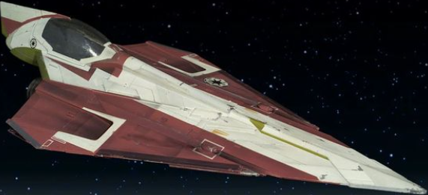
Jango Fett!! Filtering through this data has paid off! We have our culprit a bounty hunter known as Jango Fett, he carries a Blaster and wears Mandalorian armour. Thanks to master Yoda we now know exactly where he is, the isolated planet of Kamino… Kenobi informs the Jedi council and is sent to intercept Jango to unfoil his plots against the Republic

